Slide 1
UMass Lowell Computer Science COMP 4040: Analysis of Algorithms Prof. Benyuan Liu
Lecture 1
Introduction/Overview
Course webpage: http://www.cs.uml.edu/~bliu/4040-F16

Slide 2

Nature of the Course
Core course: required for all CS majors
Advanced undergraduate level
Graduate students take separate course (COMP 5030)
No programming required
“Pencil-and-paper” exercises
Lectures supplemented by:
Real-world examples

Slide 3
What’s It All About?
Algorithm:
steps for the computer to follow to solve a problem
well-defined computational procedure that transforms input into output
Some of our goals:
recognize structure of some common problems
understand important characteristics of algorithms to solve common problems
select appropriate algorithm to solve a problem
tailor existing algorithms
create new algorithms

Slide 4

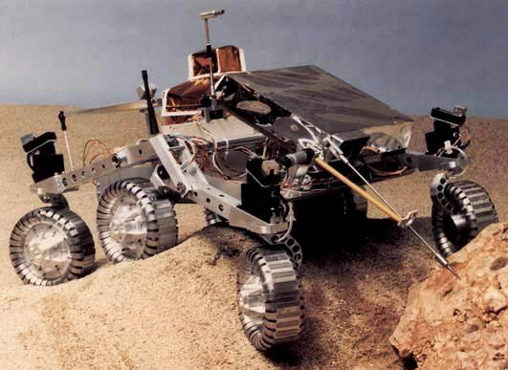
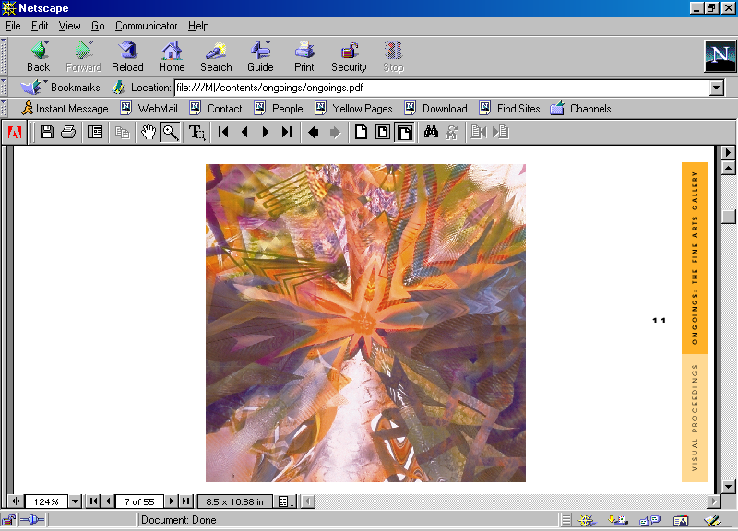
Some Algorithm Application Areas
Robotics
Bioinformatics
Telecommunications
Design
Analyze
Algorithms
Apply
Computer Graphics
Medical Imaging

Slide 5
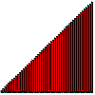
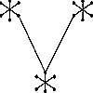
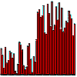
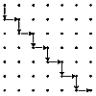
Some Typical Problems
Minimum Spanning Tree
Input: Graph G = (V,E) with weighted edges
Problem: Find subset of E of G of minimum weight which forms a tree on V
Shortest Path
Input: Edge-weighted graph G , with start vertex s and end vertex t
Problem: Find the shortest path from s to t in G
Sorting
Input: Set of items
Problem: Arrange items “in order”
Median finding
Input: Set of numbers or keys
Problem: Find item smaller than half of items and bigger than half of items
SOURCE: Steve Skiena’s Algorithm Design Manual
(for problem descriptions, see graphics gallery at http://www.cs.sunysb.edu/~algorith)

Slide 6
Tools of the Trade
Algorithm Design Patterns such as:
divide-and-conquer
Data Structures such as:
trees, linked lists, hash tables, graphs
Algorithm Analysis Techniques such as:
asymptotic analysis
probabilistic analysis
Summations
MATH
Permutations
Proofs
Combinations
Sets
Logarithms
Growth of Functions
Probability
Recurrences

Slide 7
What are we measuring?
Some Analysis Criteria:
Scope
The problem itself?
A particular algorithm that solves the problem?
“Dimension”
Time Complexity? Space Complexity?
Type of Bound
Upper? Lower? Both?
Type of Input
Best-Case? Average-Case? Worst-Case?
Type of Implementation
Choice of Data Structure

Slide 8
Prerequisites
Computing I (91.101)
Computing II (91.102)
Discrete Math I & II (92.321, 92.322)
Statistics for Scientists and Engineers (92.386)
Calculus I-II (92.131-132)
Summations
MATH
Permutations
Proofs
Combinations
Sets
Logarithms
Growth of Functions
Probability
Recurrences

Slide 9
Course Structure: 4 Parts
Part 1
Foundations
Analyzing & Designing Algorithms, Growth of Functions, Recurrences, Probability & Randomized Algorithms
Sorting
Heapsort, Priority Queues, Quicksort, Sorting in Linear Time
Data Structures
Stacks and Queues, Linked Lists, Introduction to Trees, Hash Tables, Binary Search Trees, Balancing Trees: Red-Black Trees
Graph Algorithms
DFS, BFS, Topological Sort, MST, Shortest paths
Part 2
Part 3
Part 4

Slide 10
Textbook
Required:
Introduction to Algorithms
by T.H. Corman, C.E. Leiserson, R.L. Rivest, Clifford Stein
McGraw-Hill
ISBN 978-0-262-03384-8
See course website for recommended texts
Third Edition

Slide 11
Tentative Schedule
Topic | Reading
Introduction/Overview | Chapter 1
Analyzing & Designing Algorithms | Chapter 2
Growth of Functions | Chapter 3
Divide-and-Conquer, Recurrences | Chapter 4
First Mid-term Exam | Chapter 1-4
Probability & Randomized Algorithms | Chapter 5
Heapsort/Priority Queues | Chapter 6
Quicksort | Chapter 7
Sorting in Linear Time | Chapter 8
Second Mid-term Exam | Chapter 5-8, 1-4
Data Structures | Chapter 10
Hash Tables | Chapter 11
Binary Search Trees | Chapter 12
Balancing Trees: Red-Black Trees | Chapter 13
Graph Algorithms | Chapter 22, 24
Final Exam | all above chapters

Slide 12
CS Theory Math Review Sheet The Most Relevant Parts...
p. 1
O, Θ, Ω definitions
Series
Combinations
p. 2 Recurrences & Master Method
p. 3
Probability
Factorial
Logs
Stirling’s approx
p. 4 Matrices
p. 5 Graph Theory
p. 6 Calculus
Product, Quotient rules
Integration, Differentiation
Logs
p. 8 Finite Calculus
p. 9 Series
Math fact sheet (courtesy of Prof. Costello) is on our web site.

Slide 13
Grading
Homework (~8) 25%
Midterm (1~2) 30%
Quiz (~2) 10%
Final Exam (cumulative) 30%
Discretionary (attendance, participation, etc) 5%

